Slide 1


May 2018
Textile Exchange Webinar
Kathmandu: Achieving sustainability across the materials portfolio and then telling the story!

Slide 2
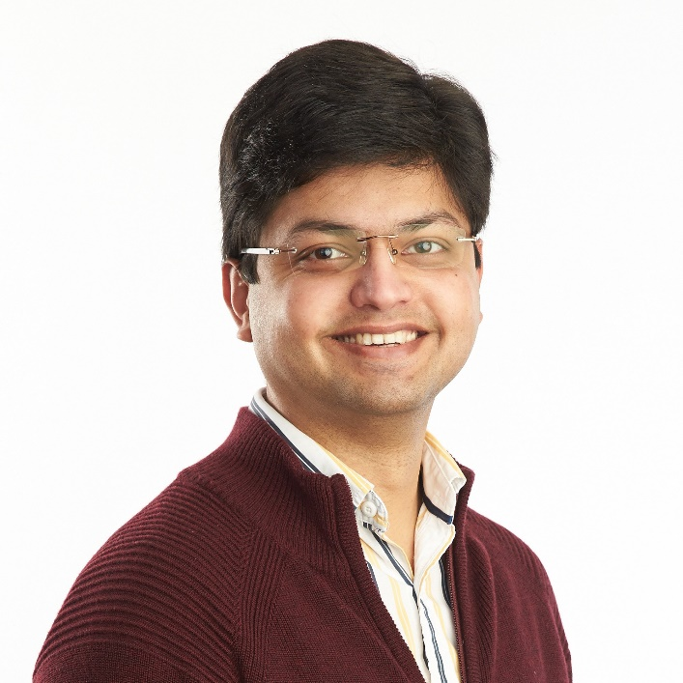
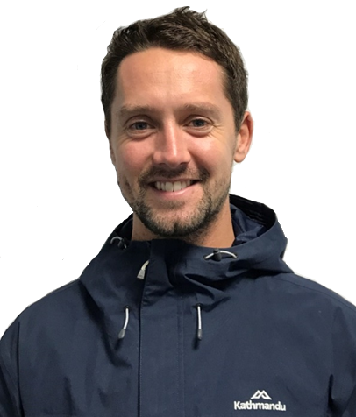
Bio’s
Manu Rastogi
Textile R&D and Responsible Materials Manager
Oliver Milliner
Sustainability Coordinator

Slide 3
Contents
About Kathmandu
Preferred Fibers and Materials (PFM)
Customer Centric PFM Prioritization
Understanding the sustainability role
The channels, audience and message
Case studies
Internal communications
Questions

Slide 4

About Kathmandu

Slide 5


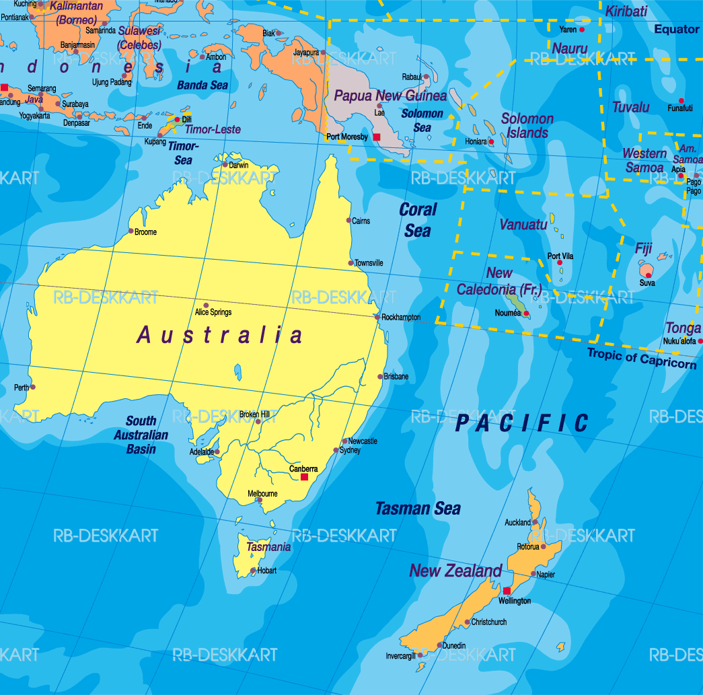
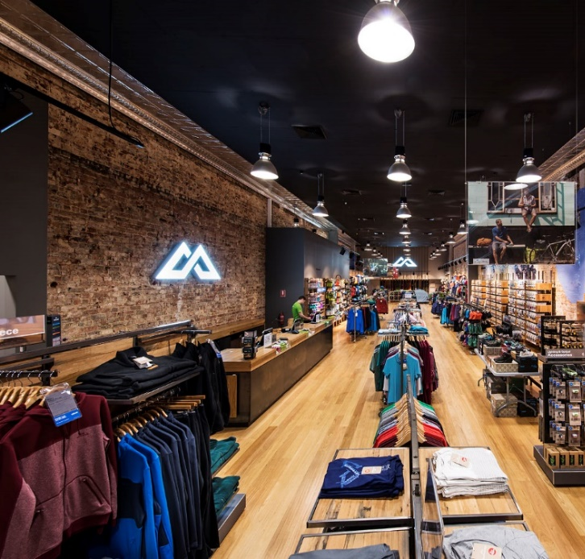
About Us
We are an outdoor brand
Our purpose is to inspire travel and adventure
Born in New Zealand, 1987
164 stores across NZ, AU and the UK
Wholesale program in Europe and the USA
Recently teamed up with Oboz
Kathmandu is publically listed
Sustainability isn’t a department, it’s a way of doing things and is core to our company ethos.
We’re all about the outdoors, so how can we help it?!

Slide 6

Achieving sustainability across our materials portfolio

Slide 7

“Sustainability is the destination
Kathmandu is the journey.”

Slide 8
Kathmandu PFM Strategy
STRATEGIC PILLARS
LEAD
INFORM
CONNECT
Lead in AU/NZ and Globally
Create Partnerships with industry peers, NGO’s, suppliers across the entire textile industry
Transparency and Traceability with all stakeholders
Participate in Industry Benchmarking & Global Rankings
Drive “Best in/for the World” Innovations
Follow Global Best Practices
Ask for help
Cultivate trust, loyalty and advocacy with our customers

Slide 9





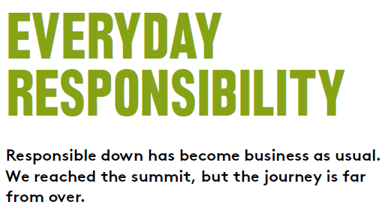
100% RDS since 2016

Slide 10


RWS Launch
Part of Advisory Group
RWS supply chain pilot programme initiated in Apr’16
Engagement with all parts of supply chain – farmer groups, topmaker, spinner, mill and garment factory
First RWS certified product on shelf in late 2018

Slide 11




Recycled
FY18 Target– 5,00,000 plastic bottles reclaimed
FY17 Target– 2,500,000 plastic bottles reclaimed
FY18 Achieved – 6,700,000 plastic bottles reclaimed
FY17 Achieved – 3,900,000 plastic bottles reclaimed

Slide 12
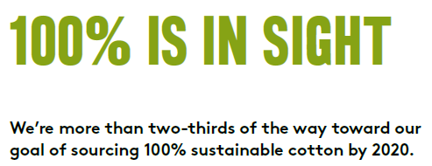

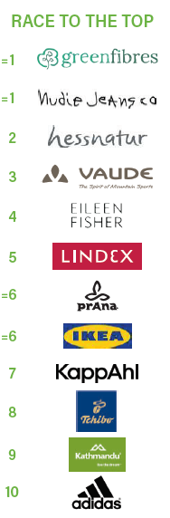

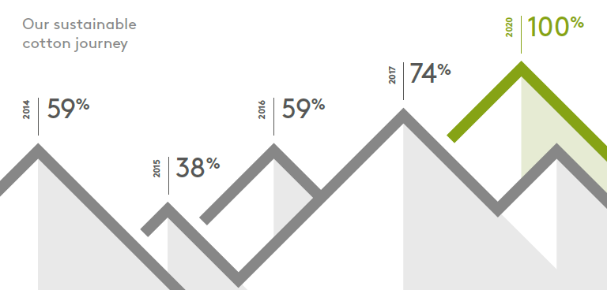




100% Sustainable Cotton by 2020

Slide 13




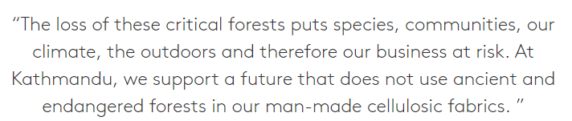
100% Preferred Man-Made Cellulosics

Slide 14
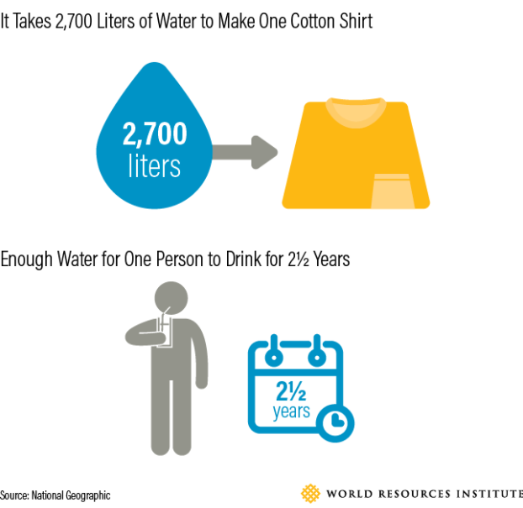
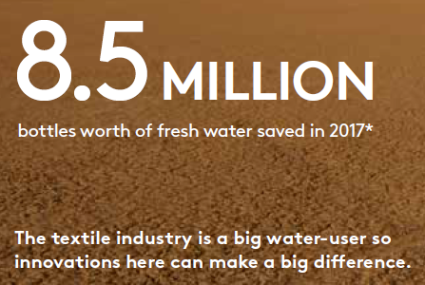
Material Solutions Targeting Water Savings

Slide 15

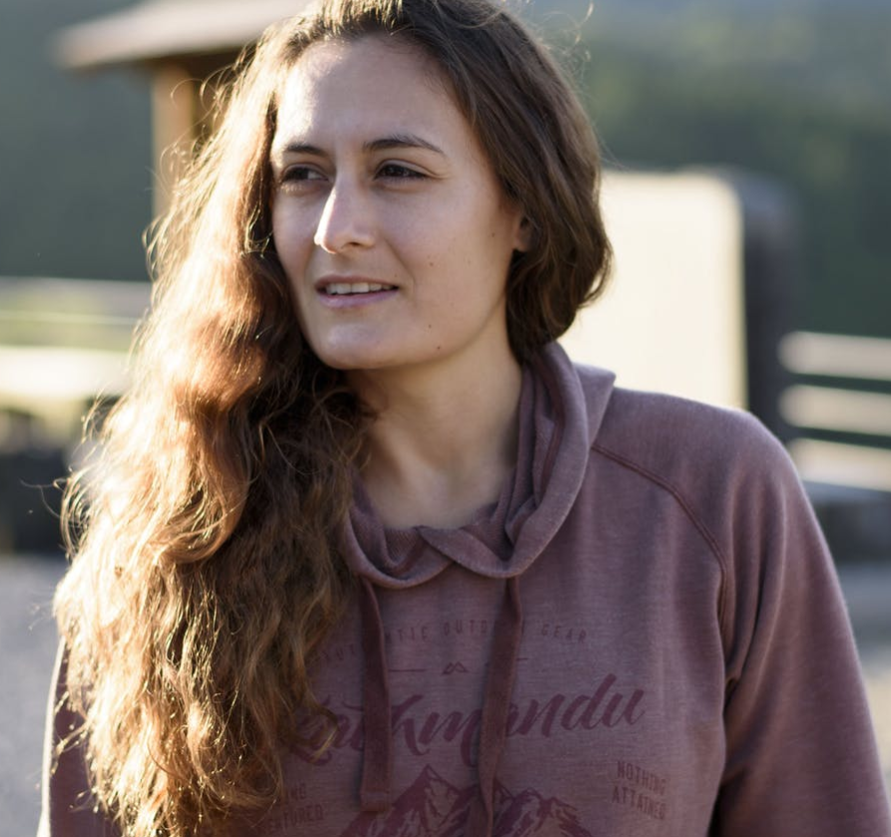



Bio-Based Synthetics

Slide 16



Others
Pledged not to sell any real fur
Target to source 100% of our leather for footwear from tanneries that are either silver or gold rated
Bluesign conversion in progress

Slide 17

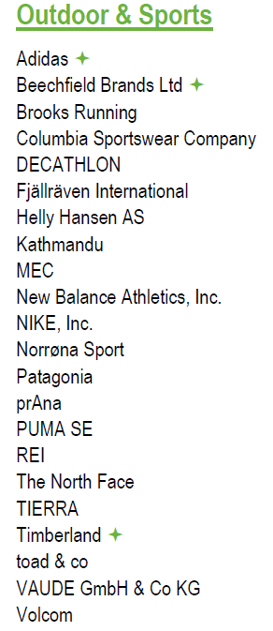
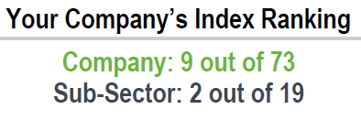
Textile Exchange PFM Ranking 2017

Slide 18

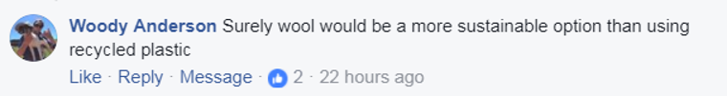

CUSTOMER Centric Prioritisation
Responsible Down
Responsible Wool
Sustainable Cotton
Recycled Polyester
Preferred Man-Made Cellulosics
Bio-Based Synthetics
Other Recycled
Bluesign Approved Materials
Material Solutions Targeting Water Savings
Material Solutions Targeting Ocean Plastics
High
ORGANISATIONAL PRIORITIES
Low
Notes:
CUSTOMERS DRIVE EVERYTHING WE FOCUS ON
MANU

Slide 19

Telling the story

Slide 20

“Sustainability isn’t a department,
it’s a way of doing things”

Slide 21
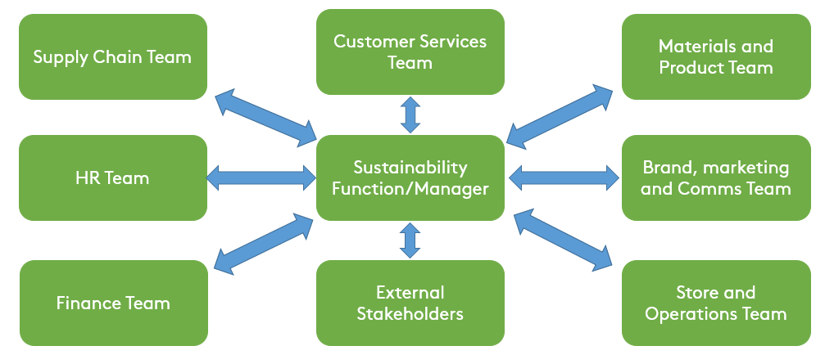
The Sustainability Function and Role
The sustainability role can be very cross functional
Key holder to inspiring stories and content
Gate keeper between business to customer
Educator and advisor for key stakeholders
Also an awakening mechanism

Slide 22
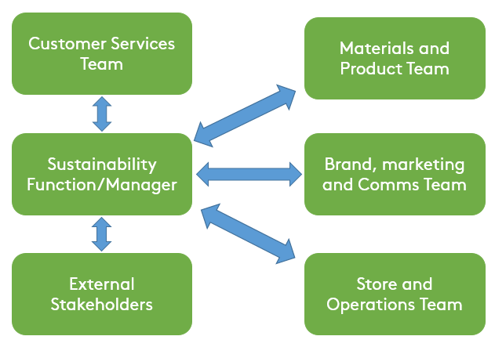

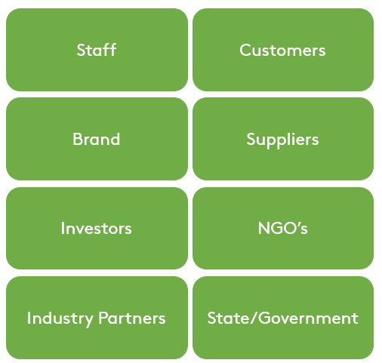
Telling the Story
External and internal communication is an omni-channelling puzzle
Telling stories and communication takes place across various channels
Decoding information and data towards marketing and comms

Slide 23


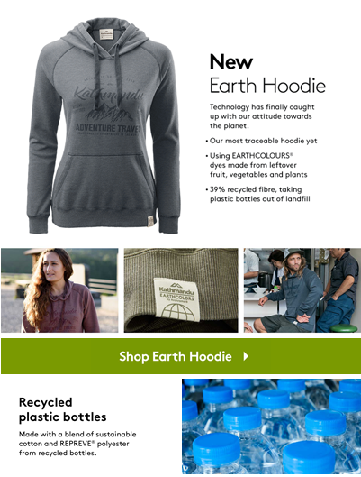
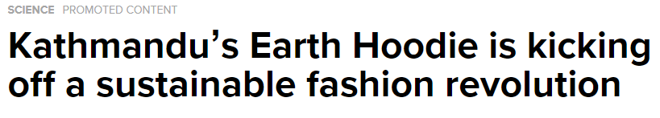
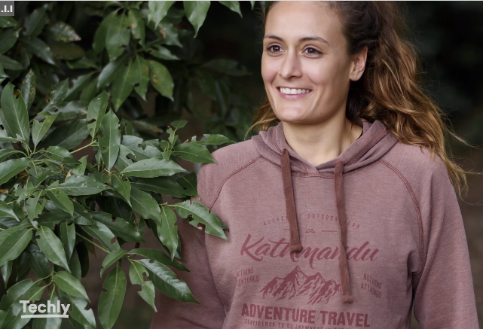
Case Study 1: The Earth Hoodie
Email/EDM
Social Media
In Store
PR

Slide 24
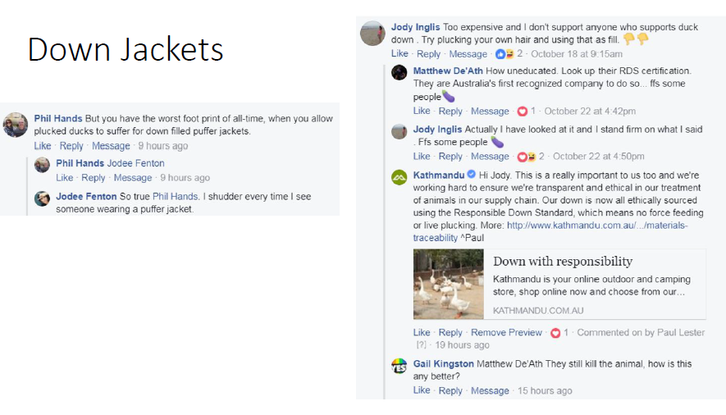
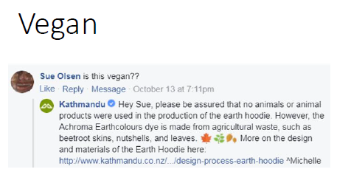
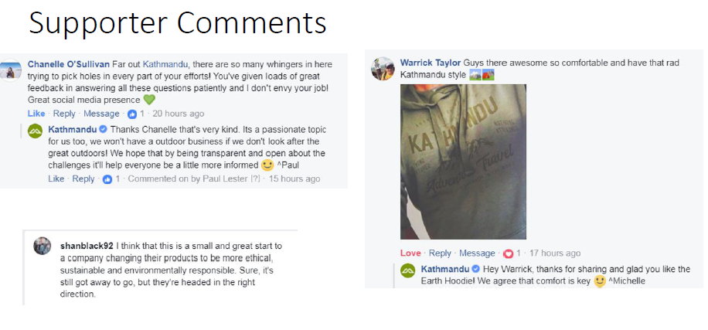
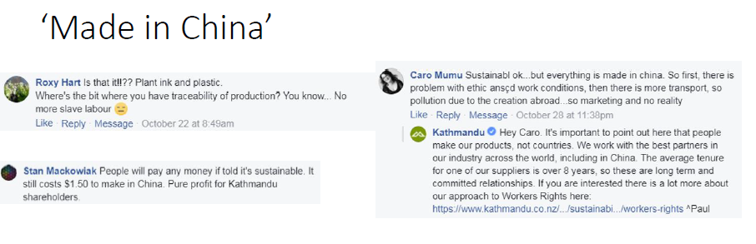
Customer Services Engagement

Slide 25
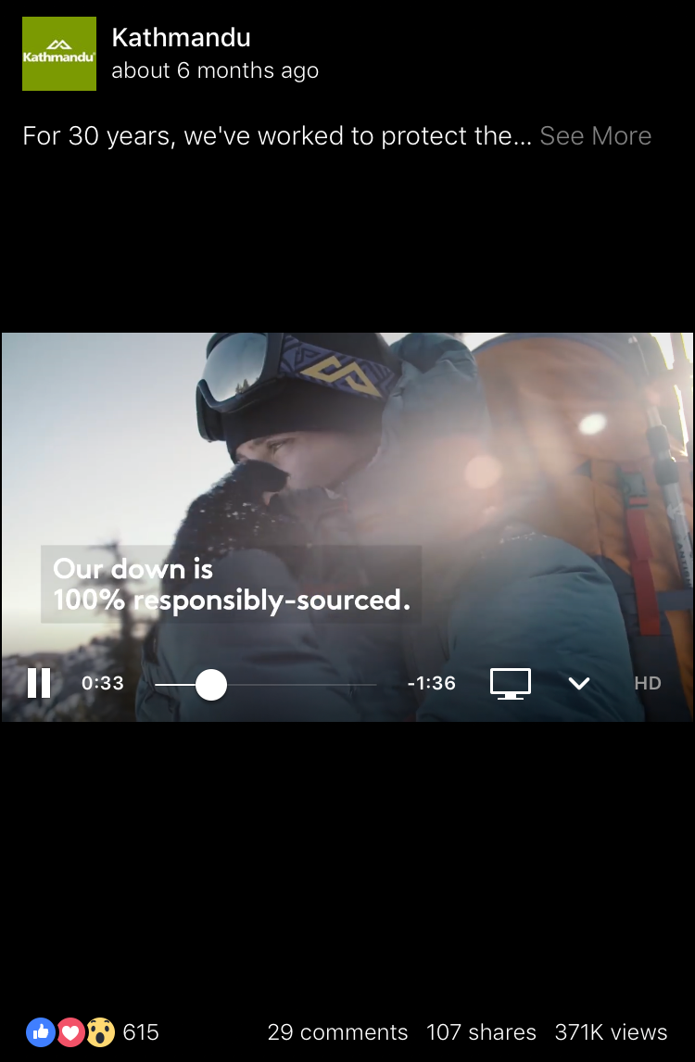
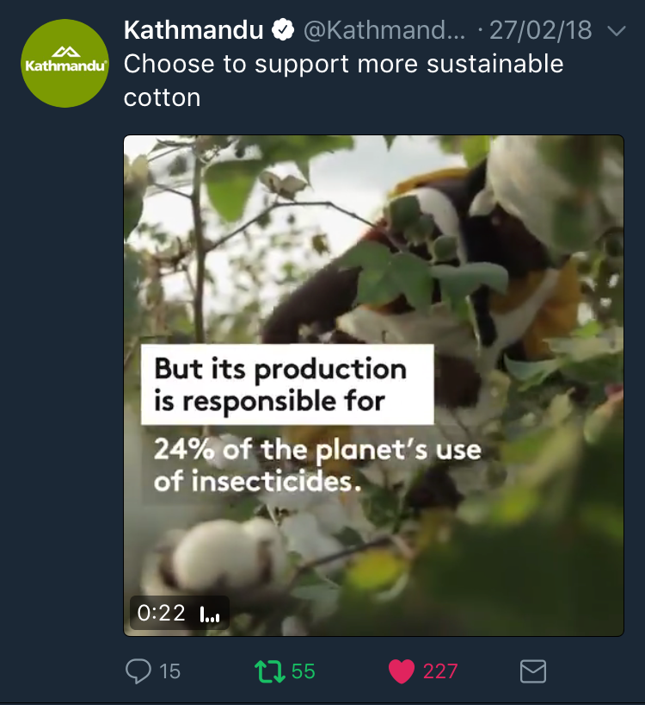
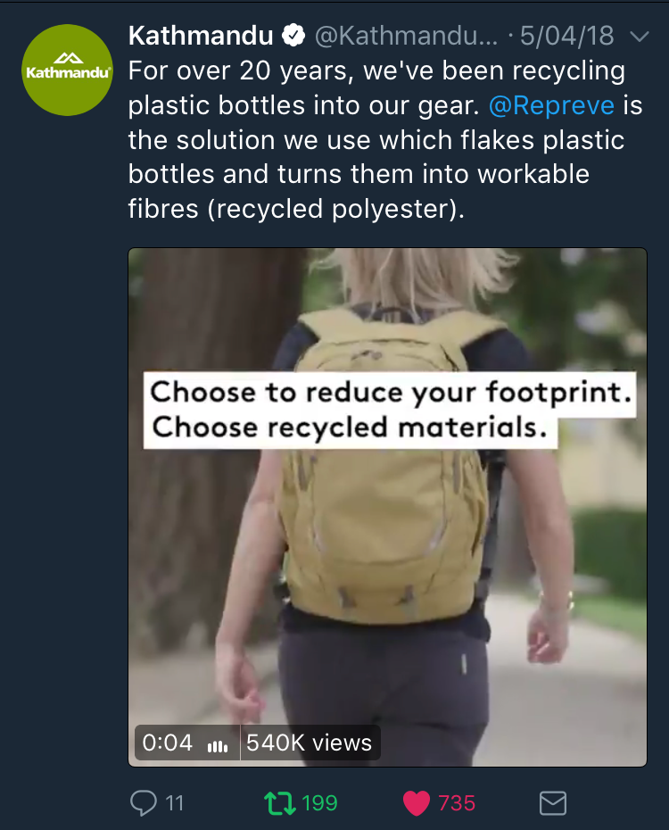
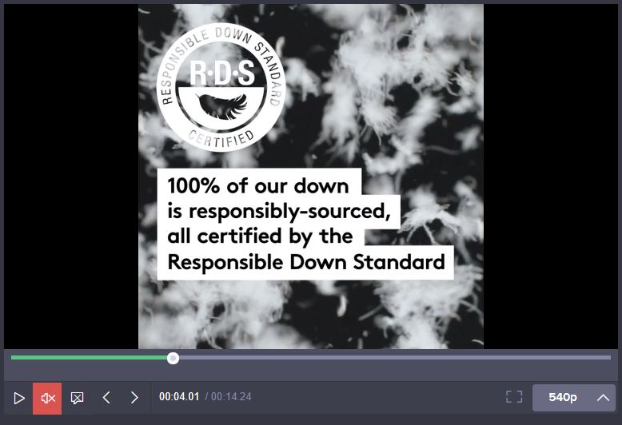
Case Study 2: Education and Customer Choice – Online

Slide 26
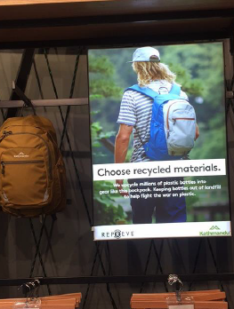
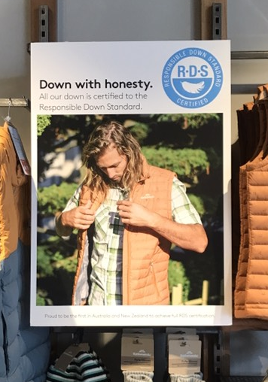
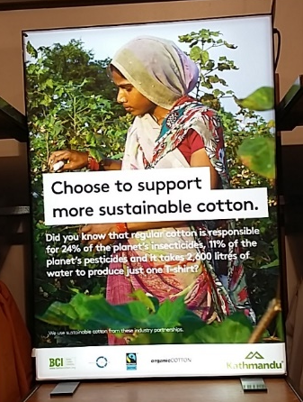
Case Study 2: Education and Customer Choice – In Store

Slide 27

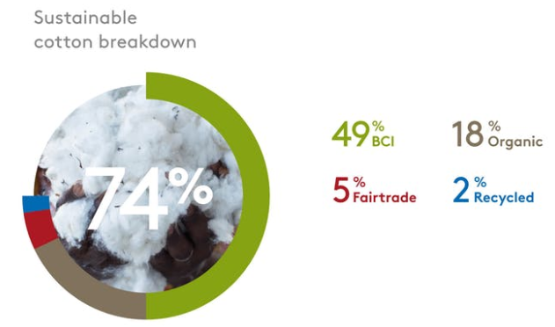
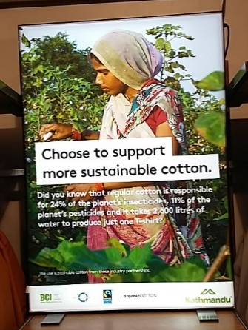
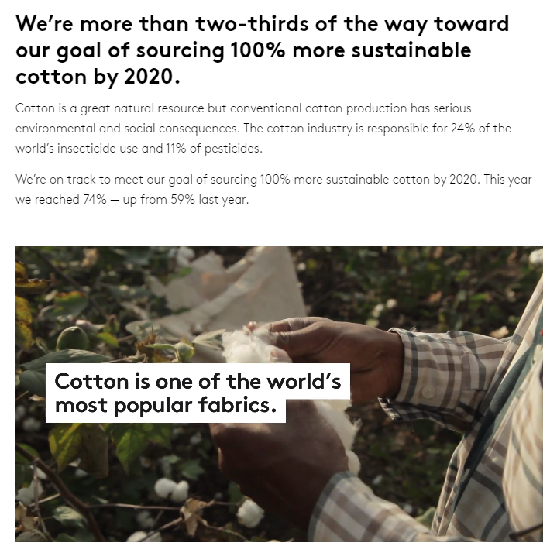
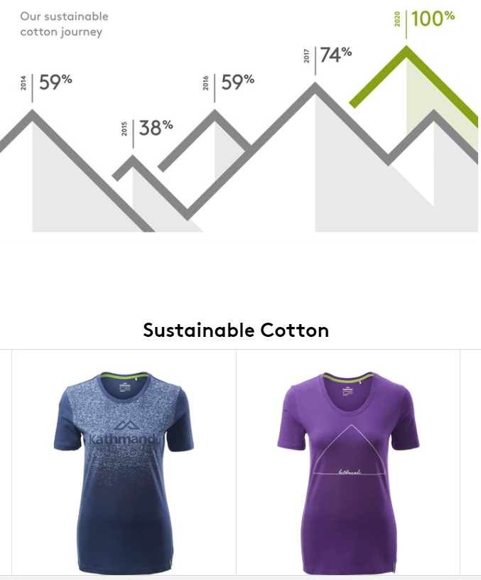
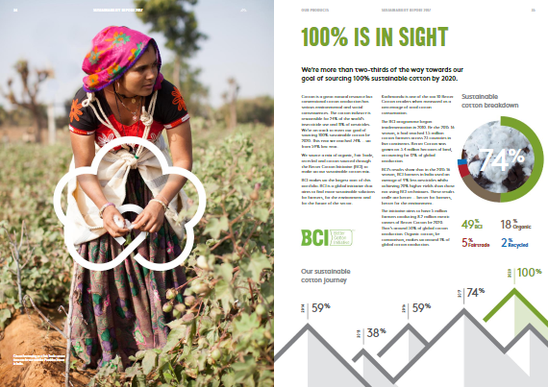
Case Study 3: Content Efficiency – Create Once
New copy
New graphics
New look and feel
New images
Updated website
Updated articles
Updated look and feel
Updated social content
Updated VM content

Slide 28
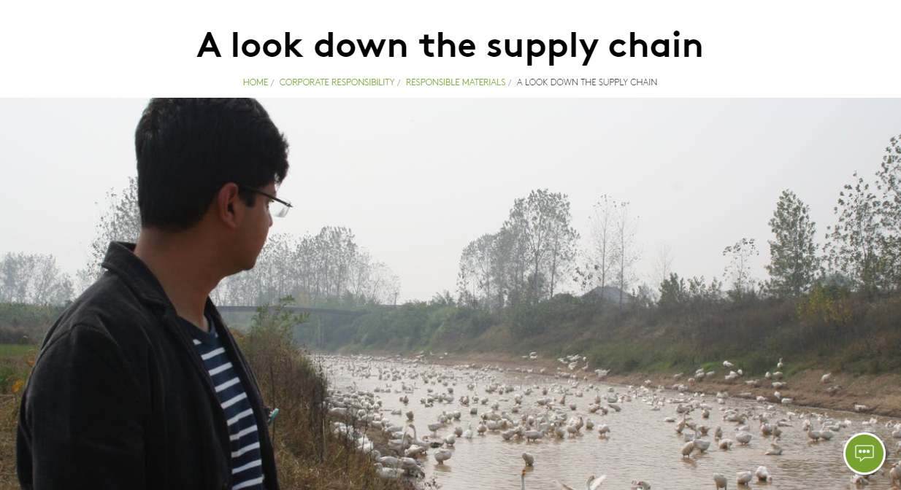
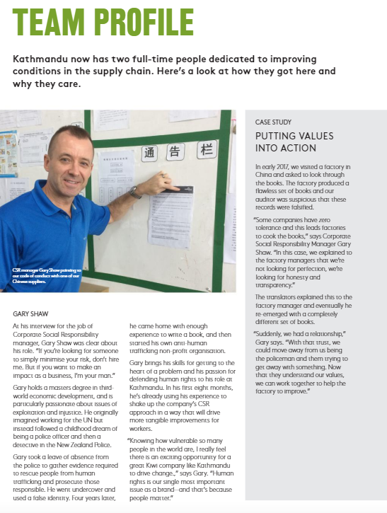
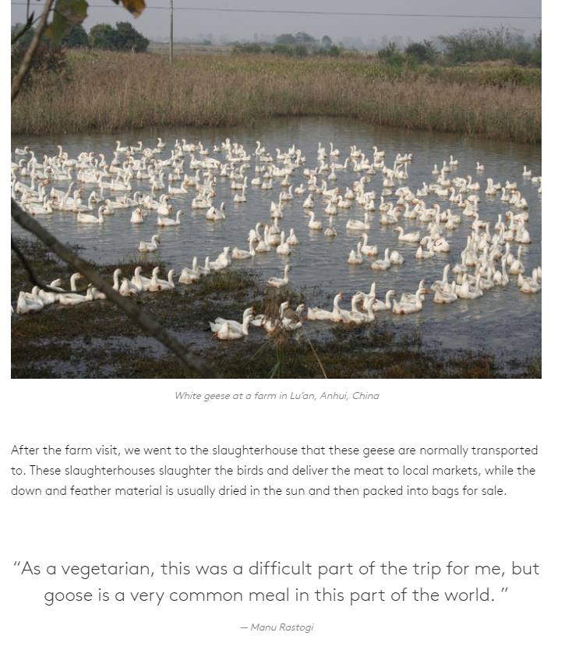
Case Study 4: Personal Story Telling

Slide 29
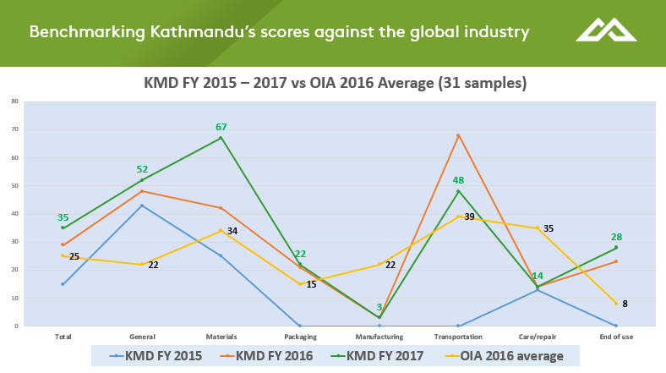
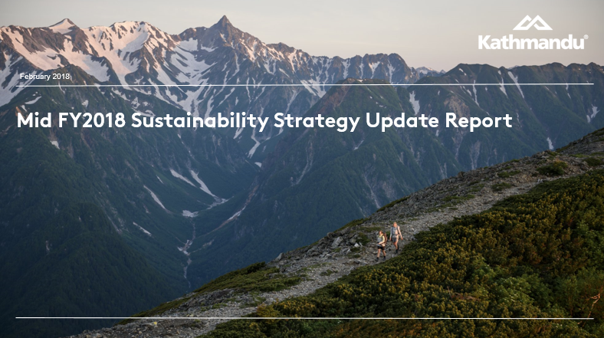
Internal Communications – Measuring Improvement in Story Telling
6 month strategy check ins
Higg Index assessments
Reviewing all actions, targets and progress
Reporting and communicating internally to all key stakeholders

Slide 30

Thank you, any questions?

